Slide 1


Single Cell Clustering Analysis with Limited Domain Knowledge using scDCC
Name & ID: Kashif Moin (14122418)
Course/Degree: MSc in Advanced Computer Science (Artificial Intelligence)

Slide 2
Agenda
Problem Motivation
Key Datasets Applied
Types of Clustering Methods Used
scDCC – Architecture & Loss Functions
Experiment Workflow
Performance Evaluation & Analysis (2 slides)
Lessons Learnt & Future Applications
Conclusion

Slide 3


Problem Motivation
Clustering single-cell RNA-seq data is essential for discovering cell types, but it’s difficult
What are the key challenges?
How can this be achieved?
What impact does it have?
With thousands of genes per cell (mostly zeros due to dropouts) and high noise, unsupervised methods often yield clusters that don’t make biological sense, requiring us to manually tweak parameters repeatedly
We can use limited domain knowledge to guide clustering so that the results are more interpretable from the start
Improves biological interpretability by producing clusters that align with known cell identities and outperform K-means and DEC, achieving 30–40% gains in ARI/NMI across multiple scRNA-seq datasets.
A deep clustering framework, like scDCC which combines a ZINB-based autoencoder with pairwise constraint learning, enabling refined clustering using limited prior knowledge while accounting for the sparsity and over-dispersion in scRNA-seq data.
Moreover, we usually have some prior knowledge – for example, a few cells we recognize or known marker genes – yet classic clustering ignores this information.
Preserves rare cell types and captures subtle cellular subtypes, while reducing manual intervention through a reproducible, semi-supervised pipeline—laying the groundwork for scalable, expert-guided single-cell analysis.
Project Motivation
This project aims to implement a reproducible pipeline that evaluates three clustering methods—K-means, Deep Embedded Clustering (DEC), and Single-cell Deep Constrained Clustering (scDCC)—across four benchmark scRNA-seq datasets: Mouse Bladder, Worm Neuron, PBMC 4k, and Human Pancreas. The goal is to assess how integrating limited domain knowledge through pairwise constraints impacts clustering accuracy, consistency, and biological interpretability.

Slide 4
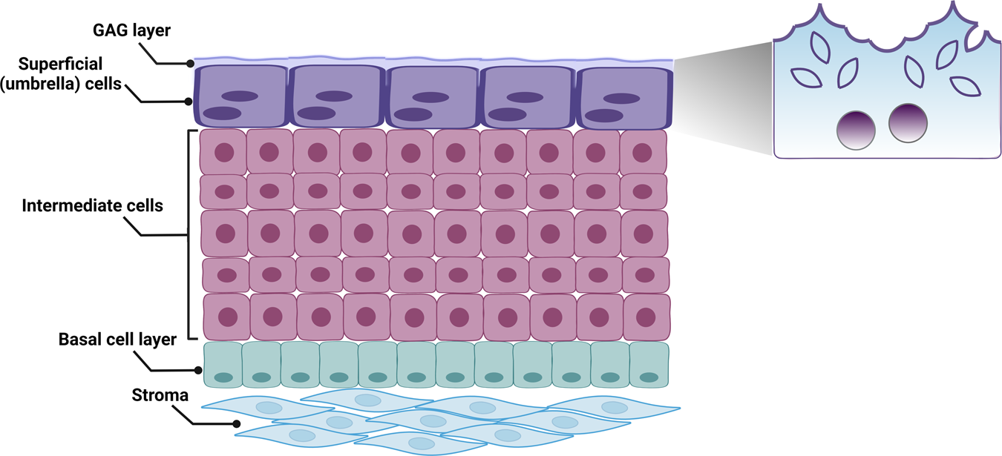
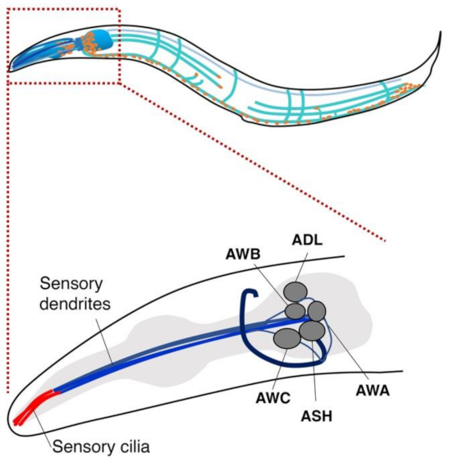
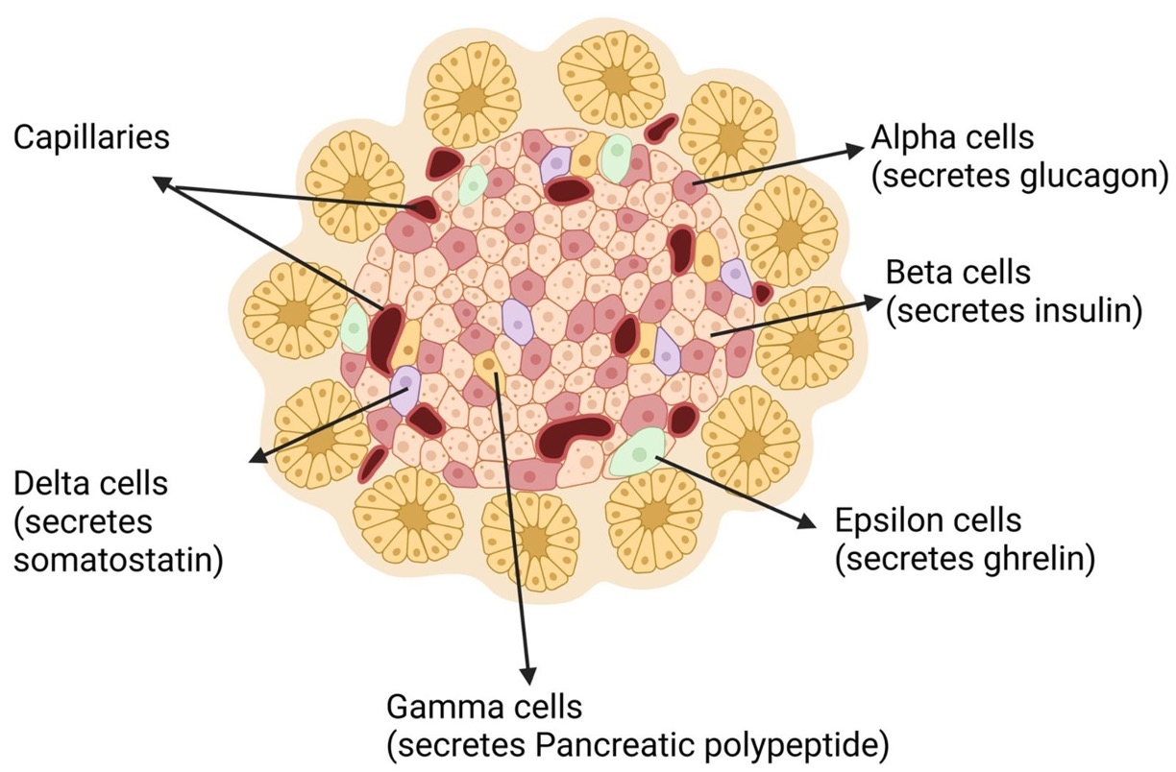
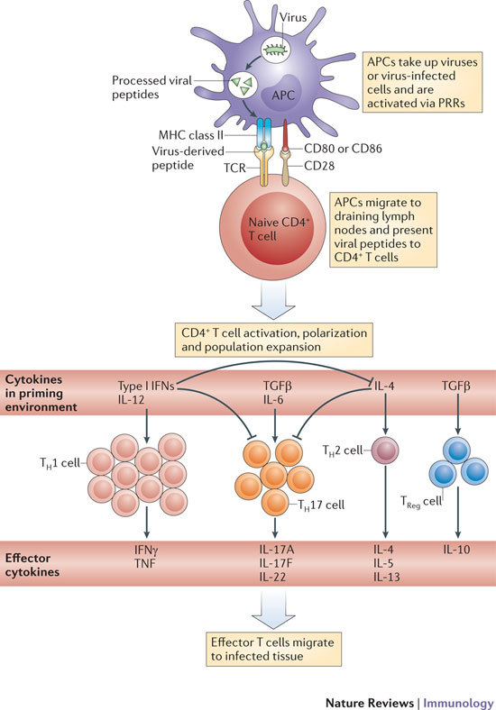
Key Datasets Applied
Standard benchmarking dataset of ~4,340 human immune cells, accessed via the scDCC Figshare repository.
Contains major immune cell types—T cells, B cells, NK cells, monocytes, etc.—with labels inferred using Cell Ranger clustering and canonical marker genes such as CD3D, MS4A1, GNLY, and CD14.Processed with Leiden clustering and marker-based annotation for pseudo-labels.
For this experiment, we have utilized four major datasets for applying single cell clustering methods
Mouse Bladder Cells (MCA)
Worm Neuron Cells
Derived from the Mouse Cell Atlas, accessed via the scDCC Figshare repository.
Captures gene expression across bladder cell populations in Mus musculus.
Includes annotated cell types: urothelial, interstitial, and smooth muscle cells.
Known marker genes like Upk3a and Krt5 aid ground truth evaluation.
Subset of neurons from the Cao et al. (2017) sci-RNA-seq atlas, accessed via the scDCC Figshare repository.
Profiles L2 larval stage neurons in Caenorhabditis elegans.
Focused on 10 known neuron subclasses (e.g., glutamatergic, GABAergic).
Ground truth derived from author annotations; WormBase marker genes used.
Human Pancreas (Baron et al. 2016)
PMBC 4K
Derived pancreatic cells from healthy human donors, sourced from GEO accession GSE84133 using inDrop technology.
Covers islet and exocrine cells: alpha, beta, delta, gamma, acinar, ductal, etc.
Annotated using marker-based Leiden clustering, aligned to original labels with validation from known markers like INS (beta cells) and GCG (alpha cells).
Standard benchmarking dataset of ~4,340 human immune cells, accessed via the scDCC Figshare repository.
Contains major immune cell types—T cells, B cells, NK cells, monocytes, etc.—with labels inferred using Cell Ranger clustering and canonical marker genes such as CD3D, MS4A1, GNLY, and CD14.Processed with Leiden clustering and marker-based annotation for pseudo-labels.

Slide 5
Types of Clustering Methods Used
Below described are the three main clustering methods that have been considered for this experiment
01
02
03
K-Means
Clustering
Deep Embedding
Clustering (DEC)
Single-cell Deep
Constrained Clustering (scDCC)
It is a classical unsupervised clustering algorithm that partitions cells into K clusters by minimizing the within-cluster variance
It is an advanced unsupervised method that learns a low-dimensional representation of the data and cluster assignments simultaneously using a deep neural network
It is a semi‑supervised deep clustering framework specifically designed to address the challenges of scRNA‑seq data, integrating biological prior knowledge through pairwise constraint learning.

Slide 6
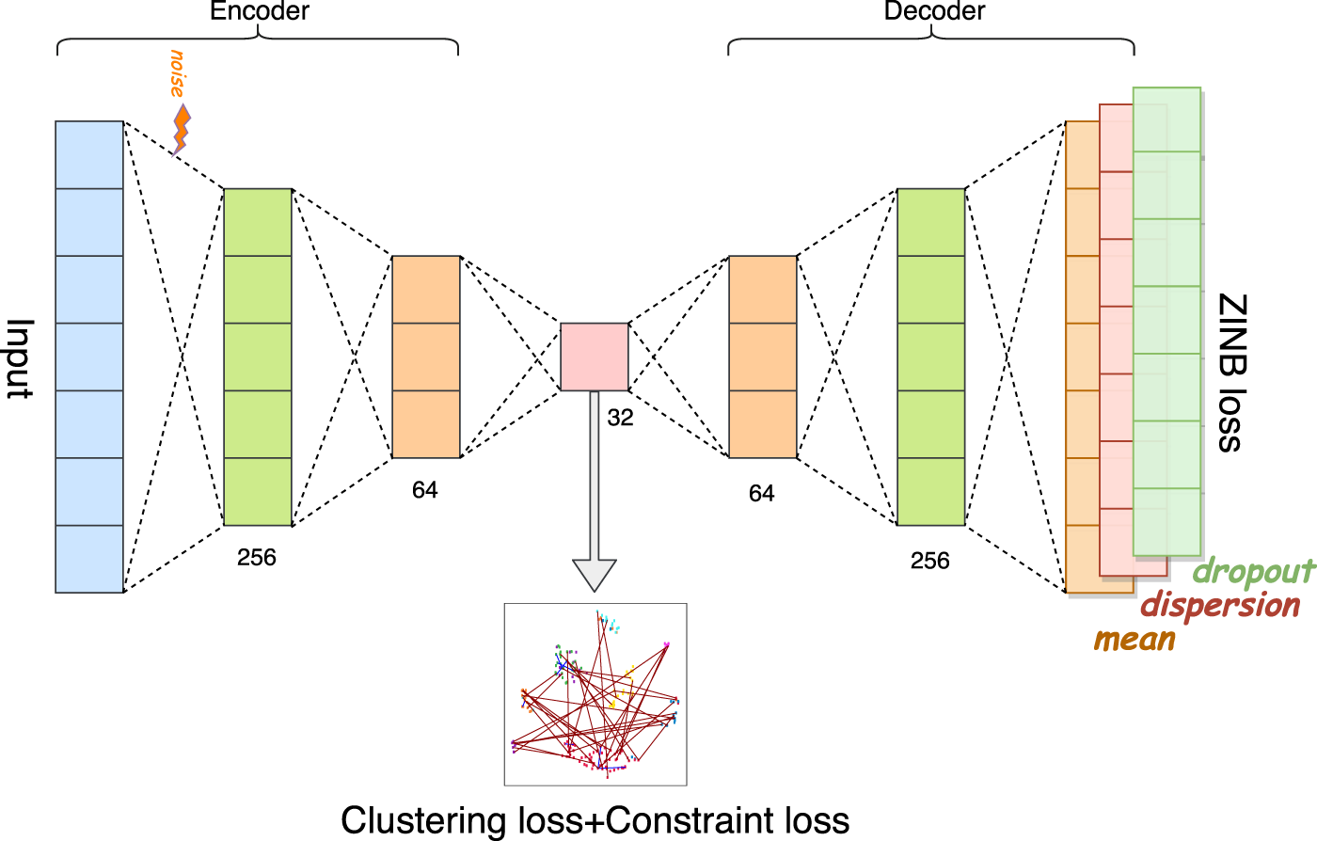
scDCC – Overall Architecture
Below illustrated is the overall architecture over which the pipeline was constructed for this clustering experiment
Architecture Overview
1. Input & Encoder:
Takes preprocessed gene expression matrix (cells × genes).
Encoder layers: 256 → 64 → 32 units.
Injects Gaussian noise for denoising and generalization.
2. Latent Embedding:
32-dimensional bottleneck layer.
Captures compressed cell representations.
Feeds into both clustering and decoder branches.
3. Clustering + Constraints:
Applies KL-divergence clustering loss.
Incorporates must-link / cannot-link constraints.
Encourages biologically consistent clusters.
4. Decoder & ZINB Reconstruction:
Decoder layers: 32 → 64 → 256 → Output
Predicts ZINB parameters: Mean, Dispersion, Dropout probability
5. Total Loss Combines:
ZINB reconstruction loss
Clustering loss
Constraint loss

Slide 7
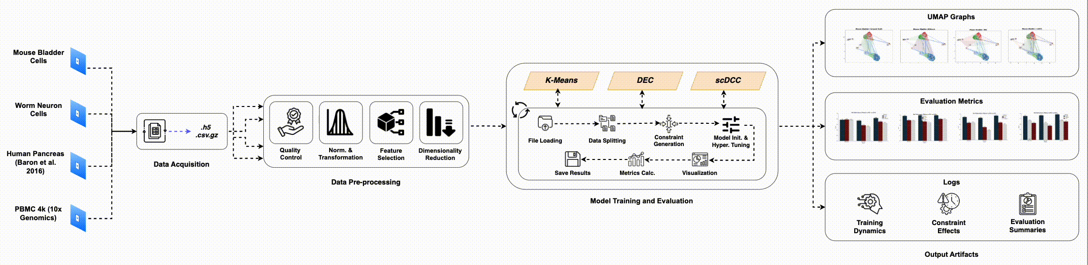
Overall Experiment Workflow
Below outlined is the overall workflow of the experiment where the three clustering methods were applied over the 4 datasets as defined
1
3
The four datasets are sourced from public repositories & saved in .h5 or .csv.gz formats
A unified notebook trains and evaluates K-Means, DEC, and scDCC on .h5ad files using a modular pipeline for data handling, constraint-based splits, training, UMAP visualisation, metric evaluation, and result saving.
2
4
All datasets were pre-processed with tailored notebooks but followed a common pipeline of quality control, normalization, feature selection, PCA, and saving outputs as .h5ad files.
Creates outputs that include UMAP visualisations, model comparison metrics, and logs of training and evaluation

Slide 8
Performance Evaluation & Analysis (1/2)
The experiment was evaluated across three major metrics – NMI, ARI and CA across the three clustering methods that were applied on each dataset
Dataset | Method | NMI (Test) | ARI (Test) | CA (Test)
Baron Pancreas | scDCC | 0.910 | 0.933 | 0.973
 | DEC | 0.643 | 0.538 | 0.701
 | KMeans | 0.732 | 0.645 | 0.736
Mouse Bladder | scDCC | 0.769 | 0.738 | 0.828
 | DEC | 0.777 | 0.570 | 0.699
 | KMeans | 0.761 | 0.520 | 0.650
PBMC 4k | scDCC | 0.967 | 0.991 | 0.989
 | DEC | 0.801 | 0.749 | 0.850
 | KMeans | 0.776 | 0.714 | 0.835
Worm Neuron | scDCC | 0.887 | 0.855 | 0.938
 | DEC | 0.662 | 0.495 | 0.674
 | KMeans | 0.673 | 0.369 | 0.602

Slide 9
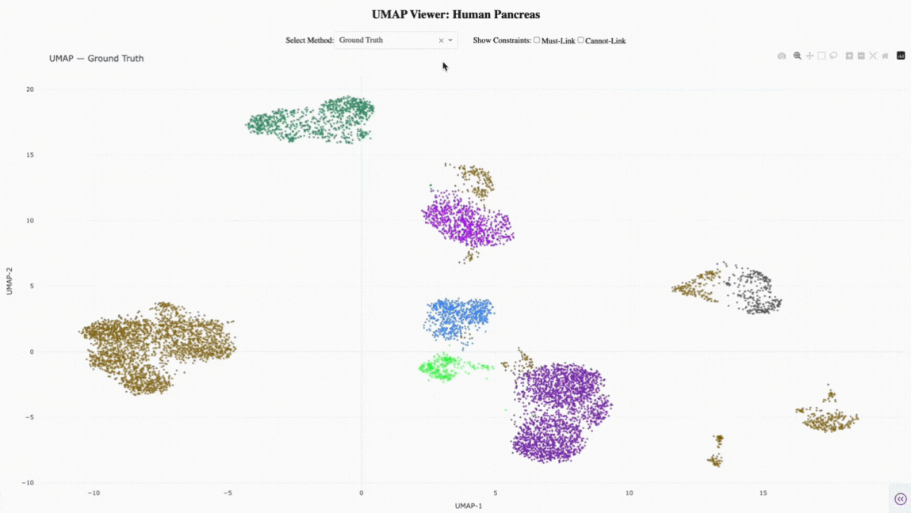
Performance Evaluation & Analysis (2/2)
Below illustrates the UMAP visualization of one of the datasets – Baron Human Pancreas dataset indicating the embeddings and cluster assignments for each method
UMAP Comparison
UMAP plots show 2D embedding of cells clustered by three methods
K-means: Poor separation; Alpha and Beta cells often overlap
DEC: Better structure, but rare cell types still misclassified
scDCC: Clear separation of all major and rare pancreatic cell types
Clusters from scDCC align with known biological identities
Demonstrates the impact of domain knowledge in improving clustering

Slide 10
Lessons Learnt & Future Applications
Below described are the key lessons learnt and identified the future applications that could be applied in extension to this clustering experiment
Future Applications
Human-in-the-loop clustering with expert-provided iterative constraints.
Active learning to automatically query the most informative cell pairs
Incorporating spatial and temporal information as constraints
Extending to multi-modal single-cell data (e.g., RNA + ATAC)
Transfer learning using constraints from existing reference atlases
Filtering and down-weighting noisy or conflicting constraints
Applying constrained clustering beyond scRNA-seq (e.g., metagenomics, pathology)
1
Semi-supervised clustering with constraints boosts clustering quality, with scDCC consistently outperforming K-means and DEC on scRNA-seq data.
2
High-quality, marker-based constraints are critical, as they guide clusters to align with known biology and improve interpretability.
YOUR TITLE 02
3
scDCC is robust across diverse datasets, showing consistent gains even with moderate constraint noise, though performance drops with heavy errors.
YOUR TITLE 03

Slide 11





Conclusion
Below are the key takeaways that we captured as part of the clustering experiment
scDCC consistently outperforms K-means and DEC by integrating limited domain knowledge through must-link and cannot-link constraints.
Constraint quality is key: curated marker-based knowledge drives performance, while noisy constraints can reduce accuracy.
Demonstrates that semi-supervised clustering bridges data-driven modeling with expert insight, making results more interpretable and biologically meaningful.
Balances reconstruction and clustering: By jointly optimizing ZINB reconstruction, clustering, and constraint losses, scDCC maintains biological signal integrity while improving cluster separability.
Robust across datasets: scDCC achieved consistently high performance on mouse bladder, worm neurons, PBMCs, and human pancreas datasets, showing strong generalizability.

Slide 12
Thank You!
Kashif Moin
kashif.moin@postgrad.manchester.ac.uk

